Slide 1
Micro-Credit Defaulter Project
Submitted by :- Prince aggarwal

Slide 2
Use Case
There are multiple telecommunication company that are providing micro loan credit to their customers which help the low financial population not to disconnect from the communication world. So, in this use case there are multiple customers which taken loan, and some don’t, so I must predict by taking important features that whether in future customers having this type of inputs and history will be able to pay back the loan or not. So, this a real-world use case which will help telecom industry to provide the loan to which type of customers.
The Consumer is believed to be defaulter if he deviates from the path of paying back the loaned amount within the time duration of 5 days. For the loan amount of 5 (in Indonesian Rupiah), payback amount should be 6 (in Indonesian Rupiah), while, for the loan amount of 10 (in Indonesian Rupiah), the payback amount should be 12 (in Indonesian Rupiah).

Slide 3
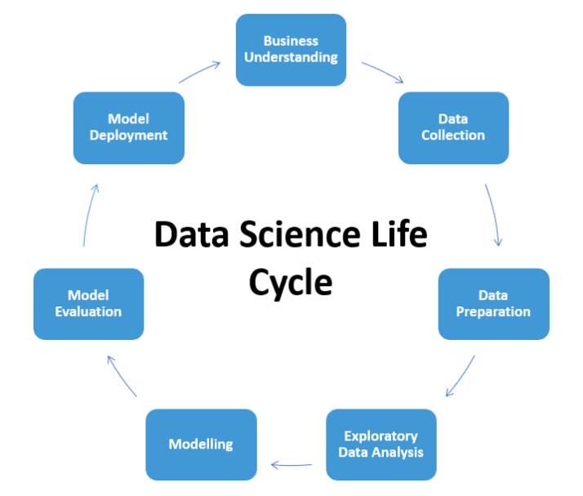
Life cycle :

Slide 4
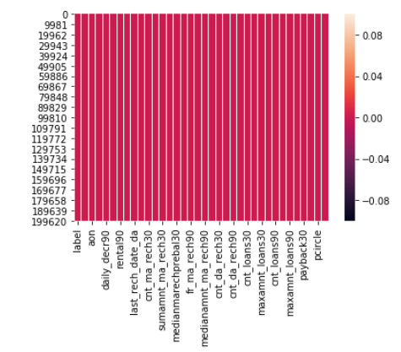
Data Preparation
With the help of Pandas Library i uploaded the data to Jupyter Notebook.
We have two type of variables in the data:-
Dependent Variable
Independent Variable
We checked the null values :
the correlation amongst the features :
# there were no null values # features are not too correlated
We checked the description of features or summary using describe()
Converted “p date” to date time datatype
Observed the datatypes of features using info()

Slide 5
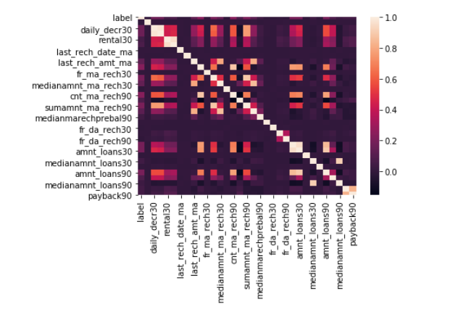
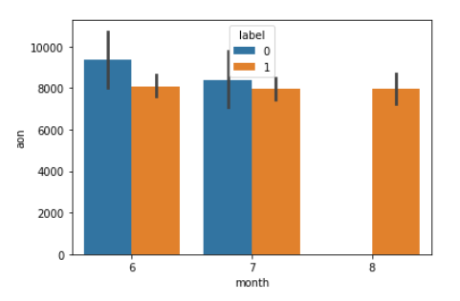
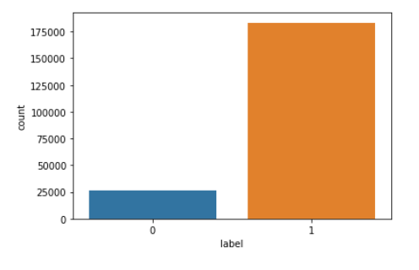
EDA:

Slide 6
EDA Remarks:
There are no null values in the dataset
There are too many outliers inside the features
The correlation heat map shows that the data is very less correlated because from the graph their is very less lighter color is showing among the columns.
The target variable “label” is bias with label = 1
In the bar plot of ‘aon’ vs month it is clearly visible that there are no defaulter in 8th month
Most of the users pay backed loan in the month of july and decrease in august month
most of the user take loan 1,2 and 3 time only

Slide 7
Feature engineering :
This step include the feature selection # some features were removed having low impact on training the data
feature scaling
There are 30+ features and most of them are continuous. So, by plotting correlation heat map it shows most then 9-10 features are highly correlated
Therefore I dropped some irrelevant columns in this step like pdate , month , year ,p circle ,msisdn .
Checked the skewness of the features
Removed outlier problem by replacing all the outlier with their respective feature upper bridge value

Slide 8
Data Pre-processing :
The Complete data is divided in the ration of 80:20 for train and test respectively.
Treating outliers:
Treating outlier by z score method can not be good approach for this model as we can not loost much data in this dataset ,therefore replacing all the outlier value by their upper bridge value using IQR seems to be a good approach.
Feature scaling:
Feature Scaling is important factor, as there are multiple features which had their magnitude and unit. So, to scale down at one scale I used Standardization.
Feature selection:
- feature selection can be done by plotting a correlation heat map and observing the features and removing all the columns highly correlated with more than 80 %

Slide 9
MODEL BUILDING:
Hyper parameter Tuning :
Hyper parameter optimization or tuning is the problem of choosing a set of optimal hyper parameters for a learning algorithm. A hyper parameter is a parameter whose value is used to control the learning process.
We tuned all the model used in the model building
Evaluation Matrices:
Accuracy - it determines how often a model predicts default and non default correctly.
Precision-it calculates whenever our models predicts it is default how often it is correct.
Recall- Recall regulate the actual default that the model is actually predict.
Precision Recall Curve - PRC will display the tradeoff between Precision and Recall threshold.
F1 score - the F1-score, is a measure of a model's accuracy on a dataset. It is used to evaluate binary classification systems, which classify examples into 'positive' or 'negative'.
Cross Validations:
K Fold cross validations , K = 10

Slide 10
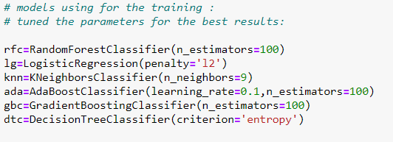
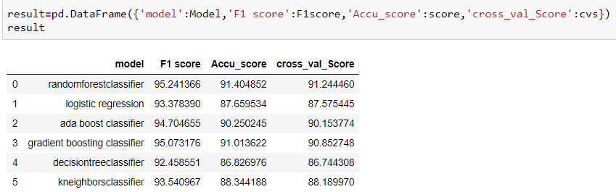
MODELS USED :
RESULTS :

Slide 11
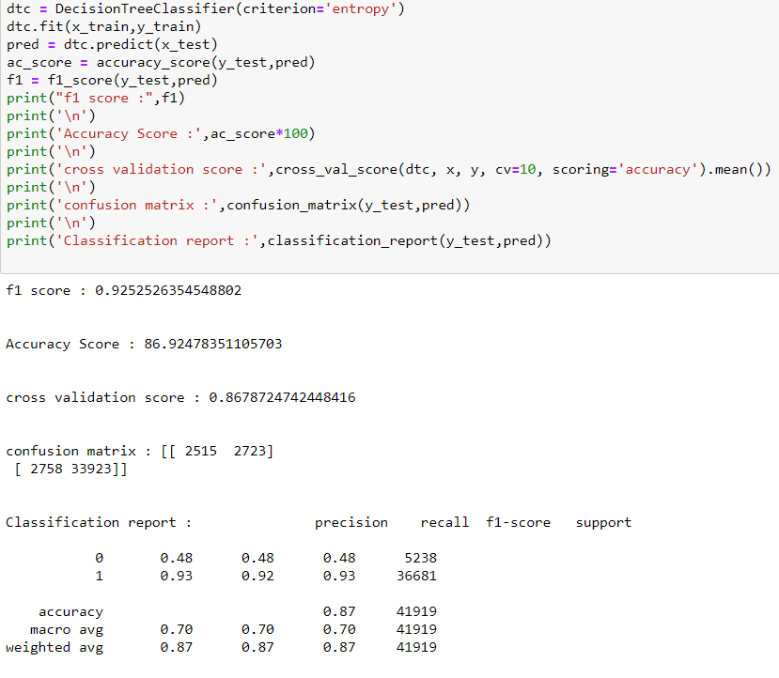
# decision tree giving best results amongst all algorithms :
Decision trees can help organizations structure and automate (complex) information. Decision trees are decision models that answer a specific question based on a question structure and certain conditions.
A decision tree is a decision support tool that uses a tree-like model of decisions and their possible consequences, including chance event outcomes, resource costs, and utility. It is one way to display an algorithm that only contains conditional control statements . As Random forest is robust to imbalance data set because of multiple week learners and internally uses decision tree and robust to outliers.

Slide 12
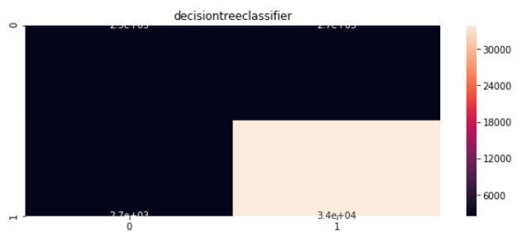
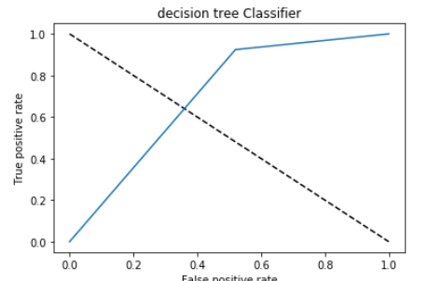
An ROC curve (receiver operating characteristic curve) is a graph showing the performance of a classification model at all classification thresholds. This curve plots two parameters: True Positive Rate. False Positive Rate.
As the Roc value is above to 0.80 so it is classified the 0 and 1 efficiently and our model is performing well in this case, and area under curve is justify the prediction.

Slide 13
Conclusion :
I check the data first and uploaded the data in jupyter notebook and than I visualize the features ,Perform the preprocessing in the data and understand the relationship between different features.
There is no defaulter in 8th month i.e. August month of 2016 year
Removing unwanted column like msisdn number which does not play any imp role because that is unique.
I used both train-validation split and the cross validation to evaluate the model effectiveness to predict the target values.
At the end I applied the six predictive models in the data.
I started with KNeighboursClassifier,Logistic Regression,
Decision Tree Classifier, random forest and based on the best result I saved to model decision tree classifier

